Slide 1
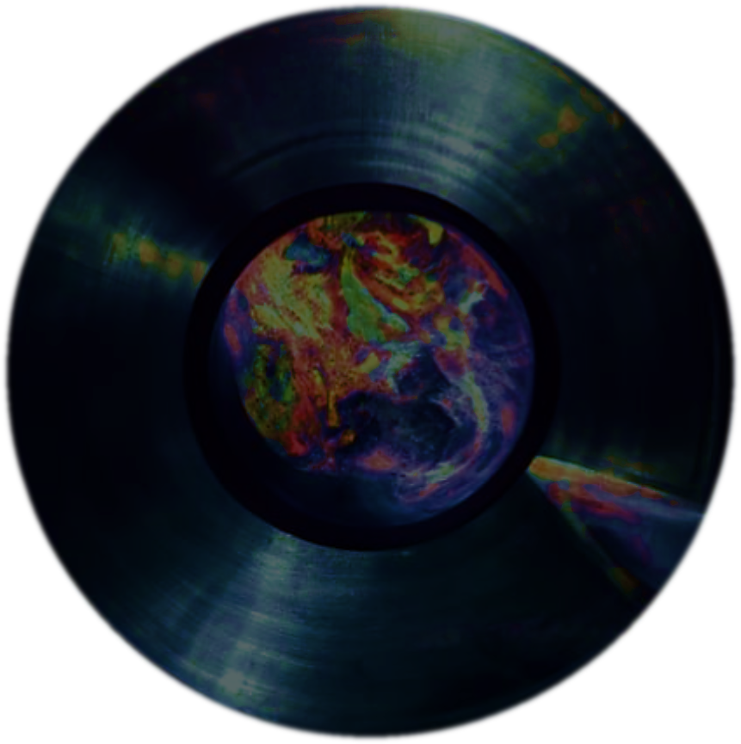


RECORDS, MUSIC, SHOPS AND KOLO: a case study on a South-Slavic music record seller in the post-WWII US
Dora Dunatov
Institute of Ethnology and Folklore Research, Zagreb
Research Assistant
International symposium “78 rpm at home”, Zagreb, 11 March 2023

Slide 2
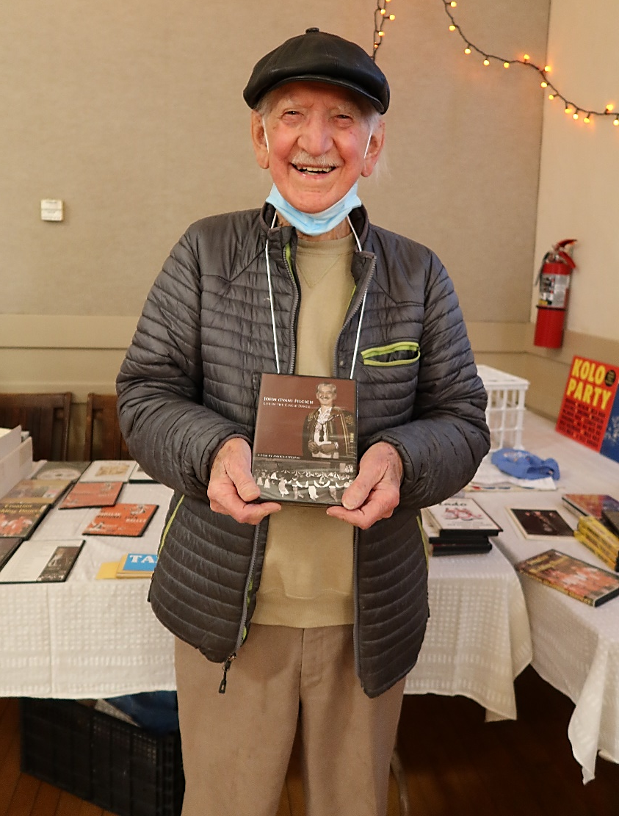


IVAN (JOHN) FILCICH
(Rijeka, 1924)
a.k.a.
KOLO JOHN
Petaluma, CA. 20/5/2022

Slide 3


Slide 4
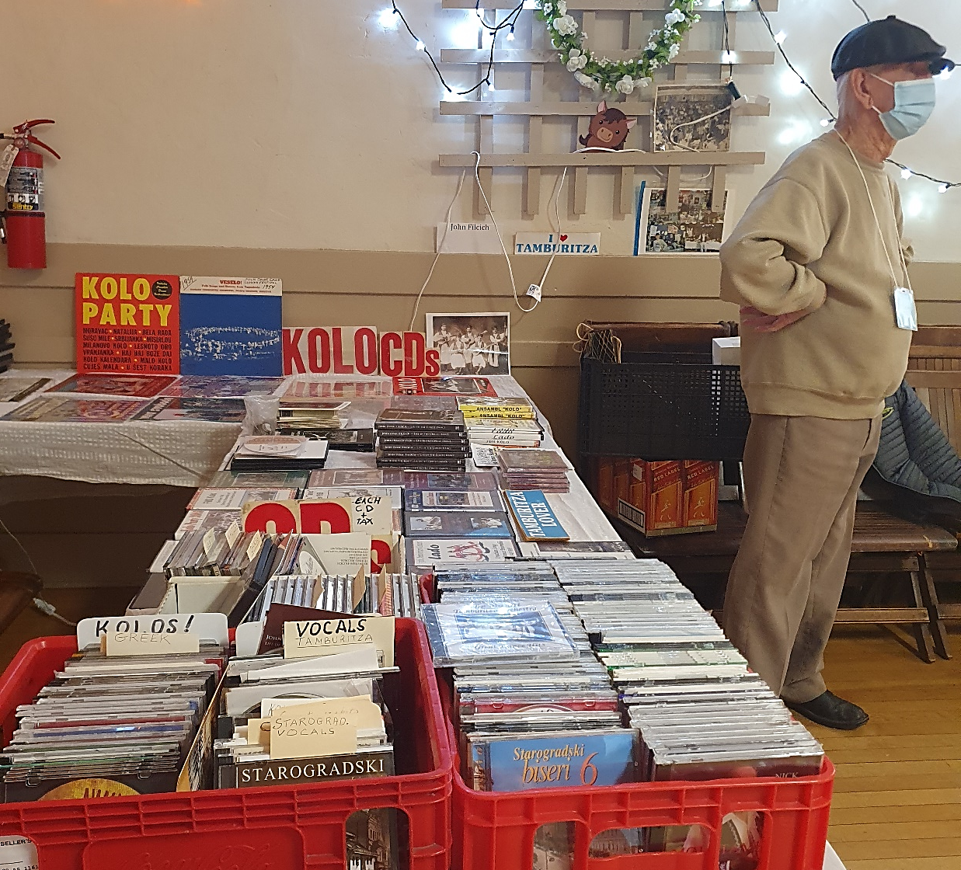
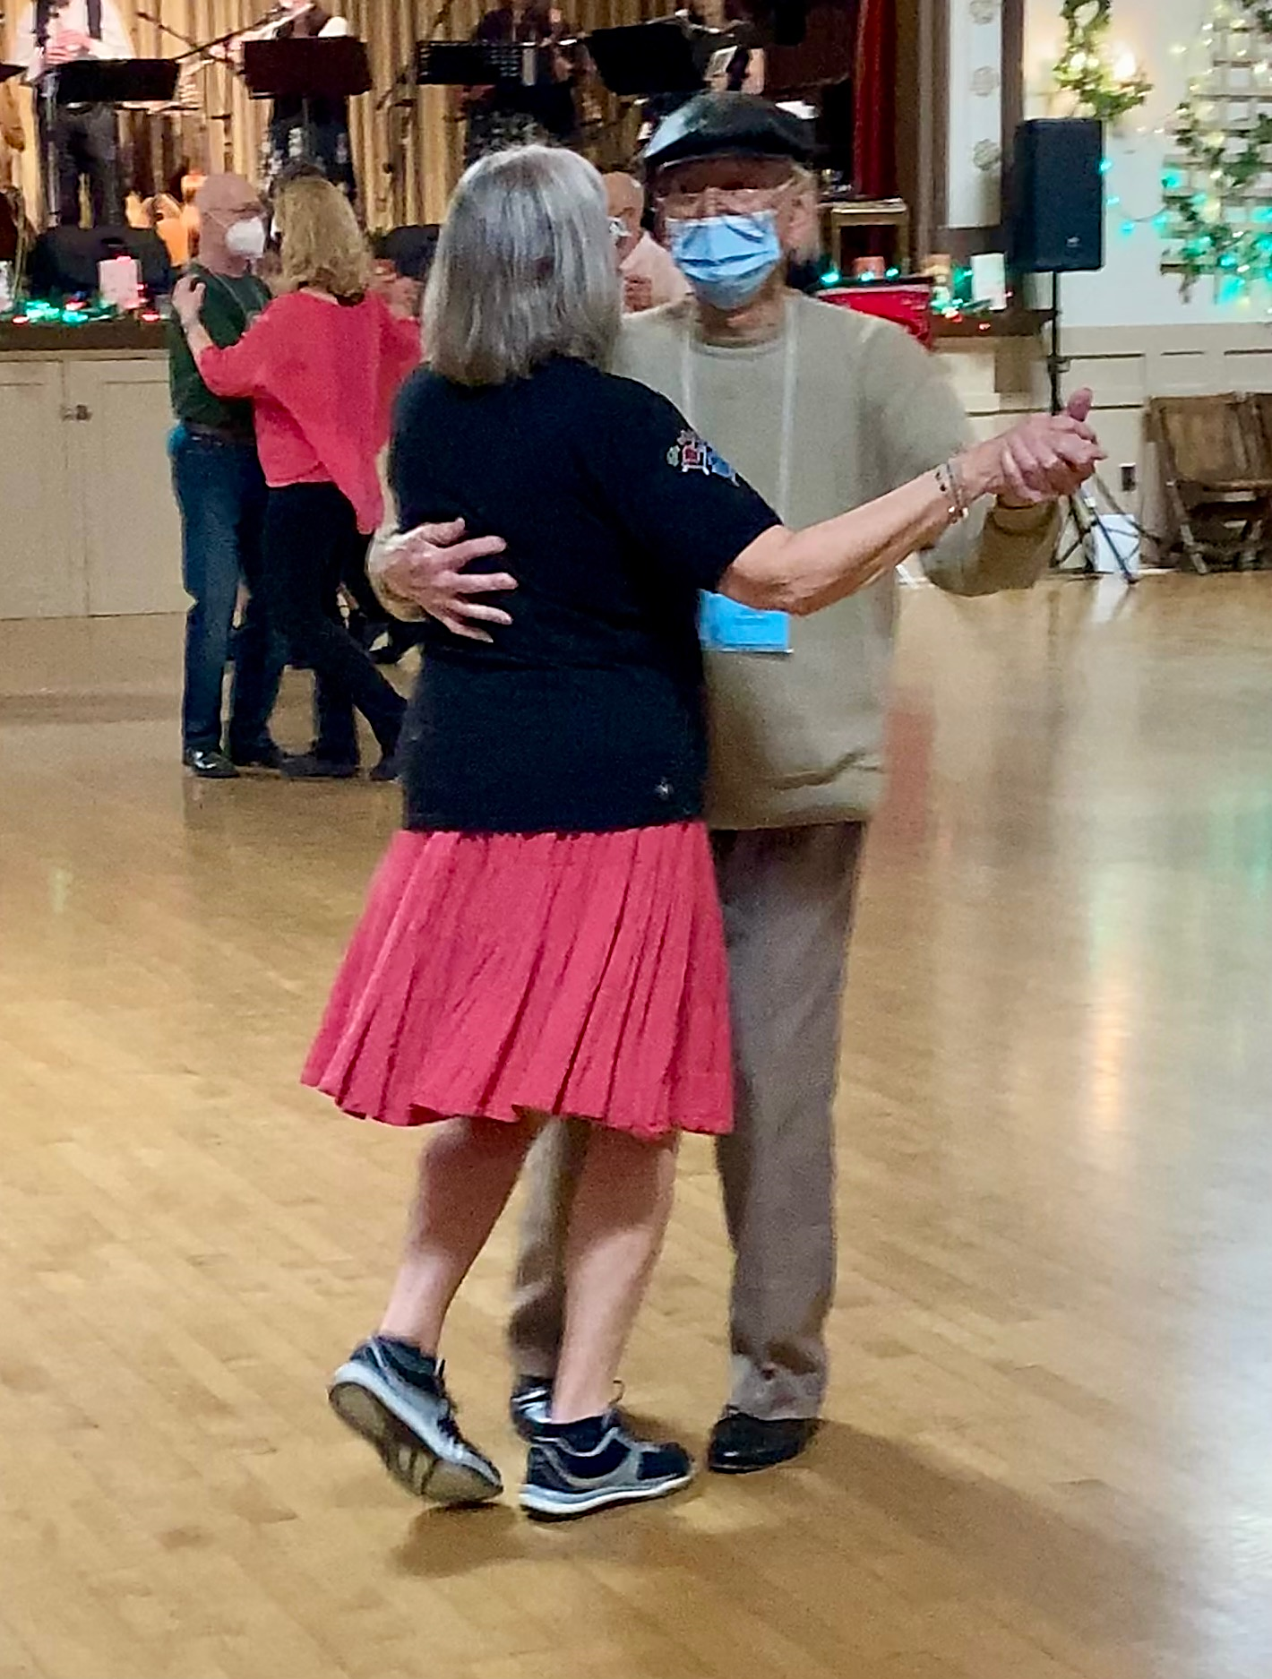
DUNATOV: What’s the greater passion, kolo or the records?
FILCICH: Both, they go together. One could not exist without the other, without music, there’s no dance.
Petaluma, CA. Statewide folk dance festival 20-22/5/2022

Slide 5
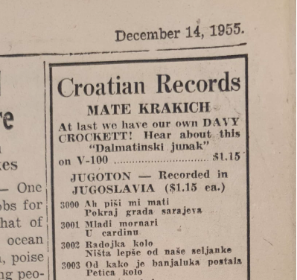
SOME RESEARCH QUESTIONS
Did Zagreb-based record companies reach the US?
Who was the audience?
Which repertoire sold the best?
Who were the sellers?
What were the profiles and marketing strategies of the sellers?
Zajedničar newspaper, Croatian Fraternal Union (12/12/1955)
D. Dunatov: Records, music, shops and kolo

Slide 6
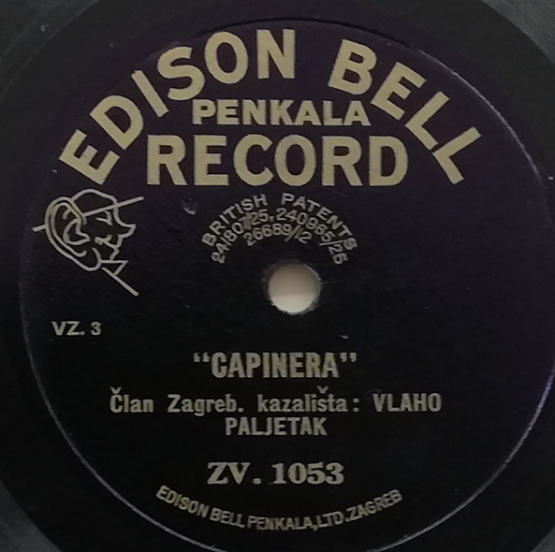
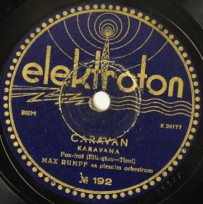
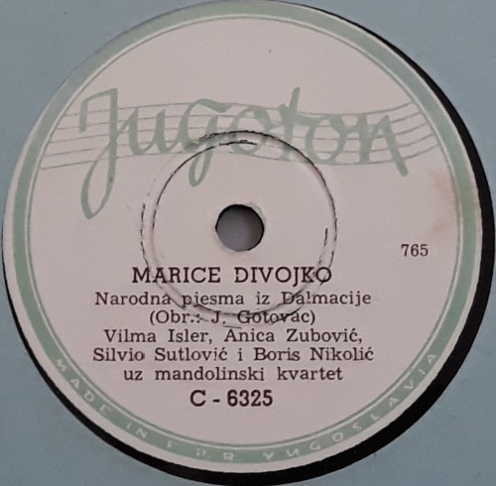
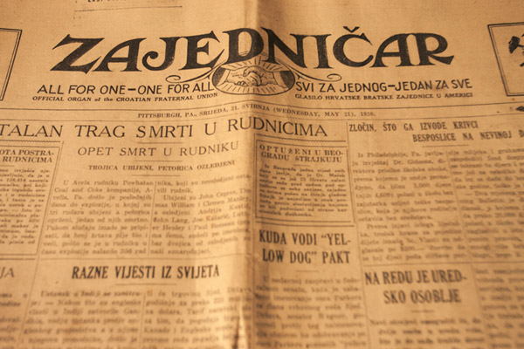
1920
1930
1940
1950

Slide 7
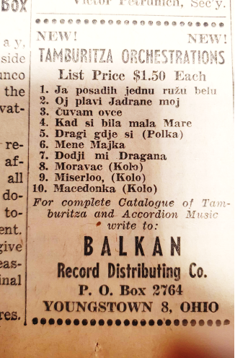
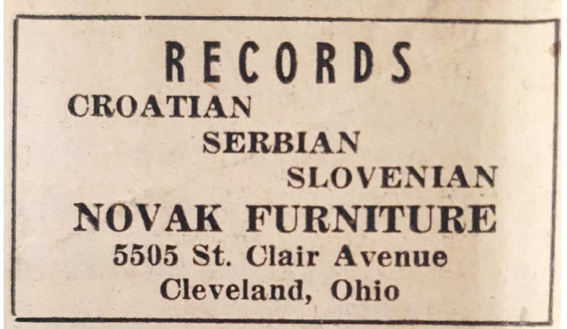
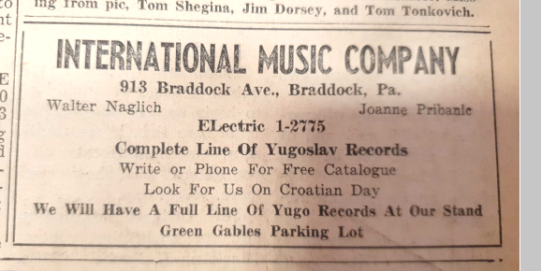
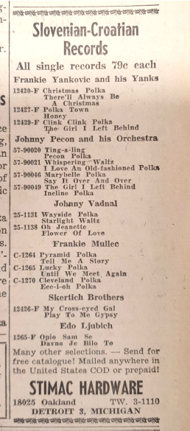
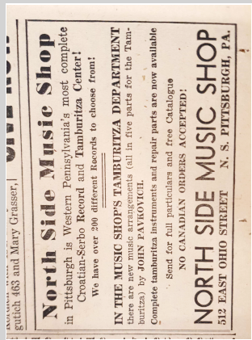
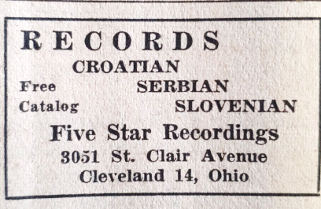
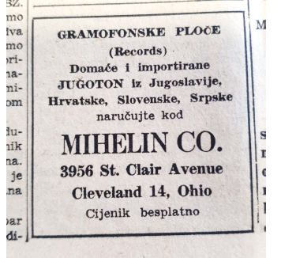
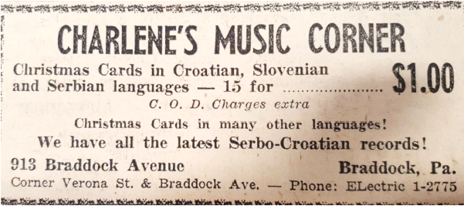

Slide 8
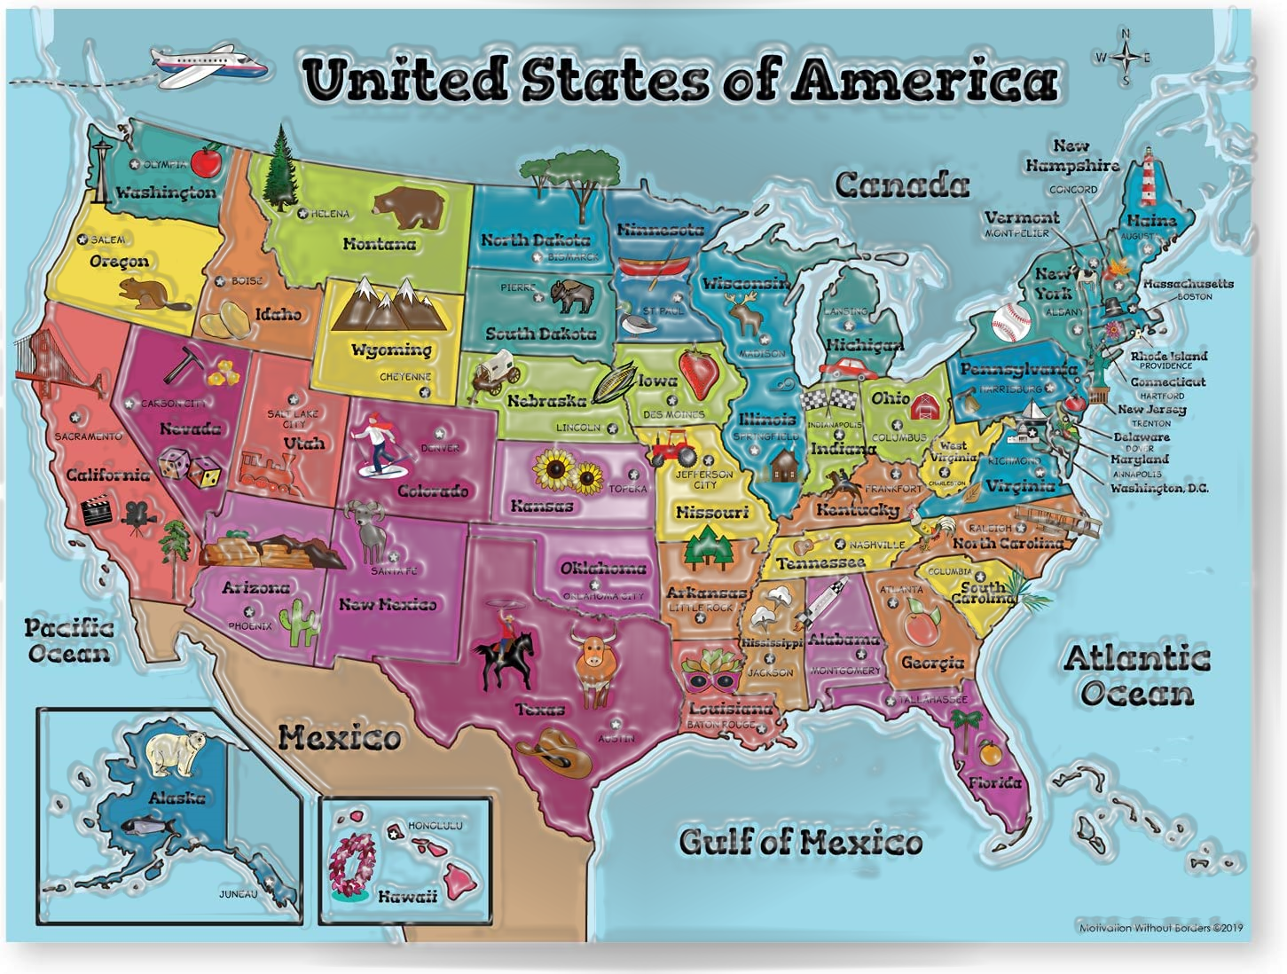
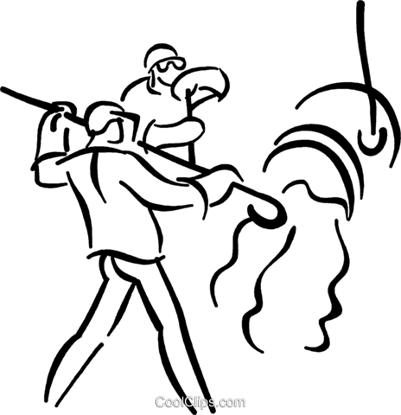
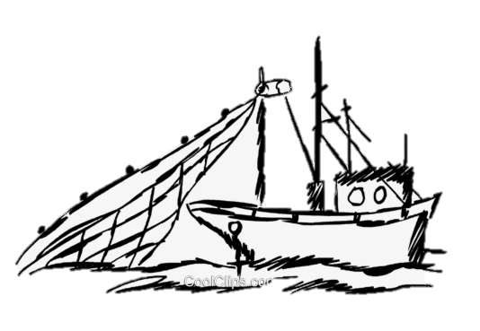
LIST OF RECORD SELLERS ADVERTISEMENTS IN ZAJEDNIČAR NEWSPAPER (CFU, 1946-1959)
W. Fischer-Nebmaier (2019):
”John R. Palandech (1874–1956): The Many Faces of a Chicago Transatlantic Immigrant Media Man”
MIHELIN CO.
SUPERIOR MUSIC CO (Nicholas Badovinac)
FIVE STAR REOCRDINGS
NOVAK FURNITURE
PALANDAČIĆ / PALANDECH’S BOOK STORE (John Palandech)
BALKAN MUSIC CO
JUGOSLAV RECORD SHOP (John Filcich)
SLAV-ART MUSIC CO (John Filcich)
STIMAC HARDWARE
STIMAC HARDWARE
New York
SONART MUSIC CO
Detroit
Cleveland
Chicago
Youngstown
Pittsburgh
San Francisco - Oakland
BALKAN RECORD DIST. CO (John Krilcic)
NORTH SIDE MUSIC SHOP (John Pavkovich)
CHARLENE’S MUSIC CORNER
INTERNATIONAL MUSIC CO (Walter Naglich & Joanne Pribanic)
Los Angeles
SONART / AMERICAN MUSIC CO
BOWER’S MUSIC

Slide 9
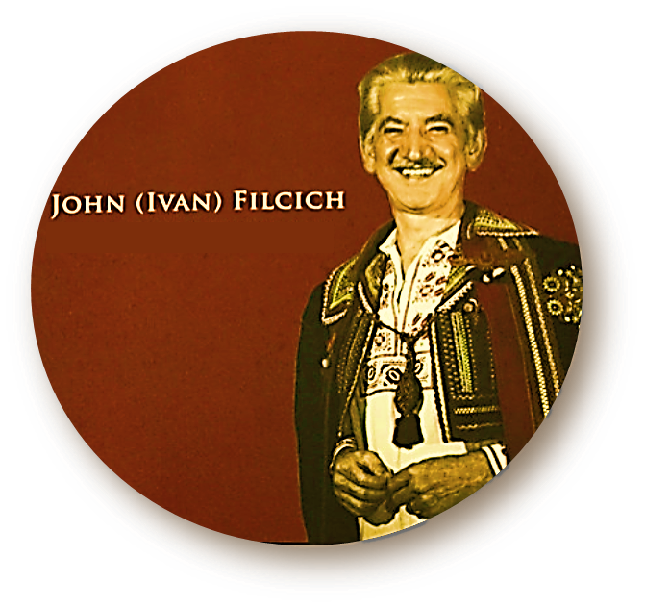

JUGODISK
CUSTOMERS
REPERTOIRE
JUGOTON
HOMELAND
COLLECTOR
VICTOR &
COLUMBIA
3 STORES
IMMIGRANT
ETHNICS
KOLO
CROAT
KOLO
FESTIVAL
OAKLAND
YUGOSLAV
PRICE
COMPETITION
LOS ANGELES
SAN FRANCISCO
SLAV-ART MUSIC CO.
YUGOSLAV REC. SHOP
INTER-
NATIONAL

Slide 10
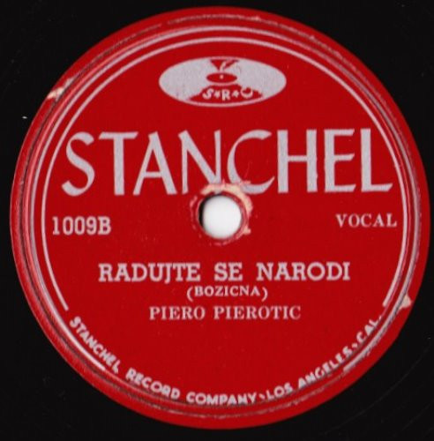
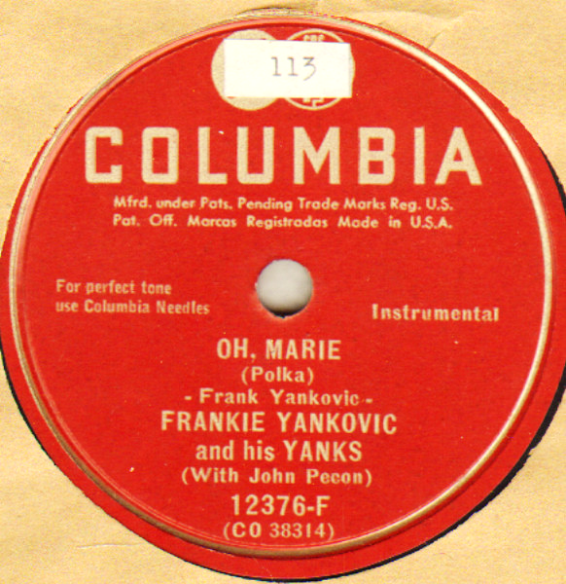
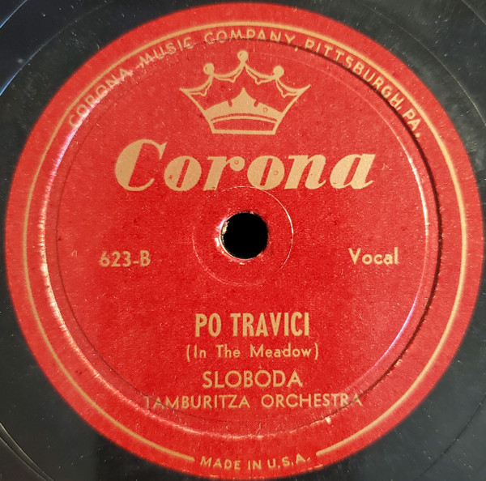
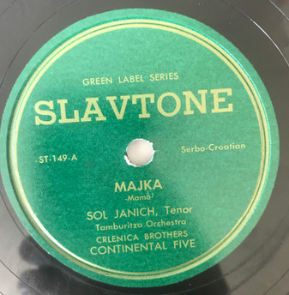
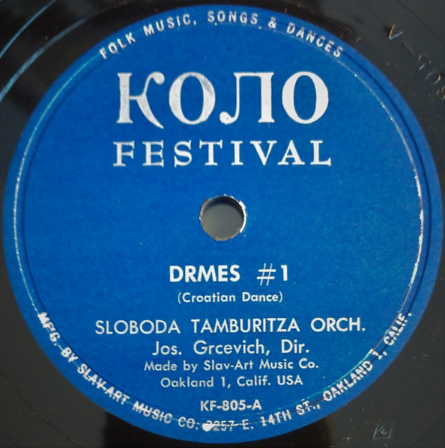
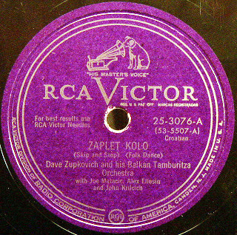
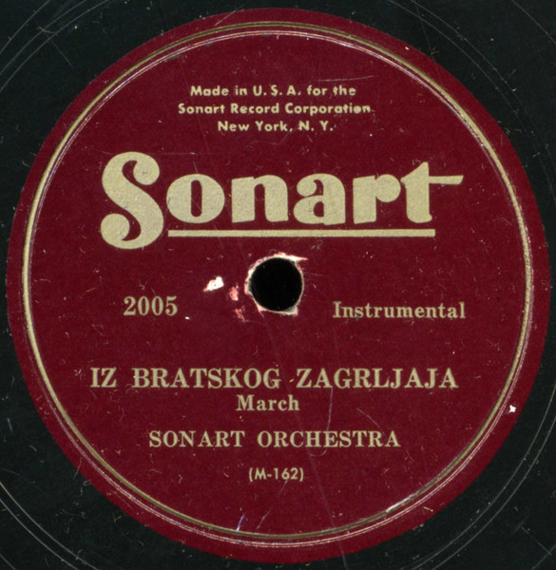
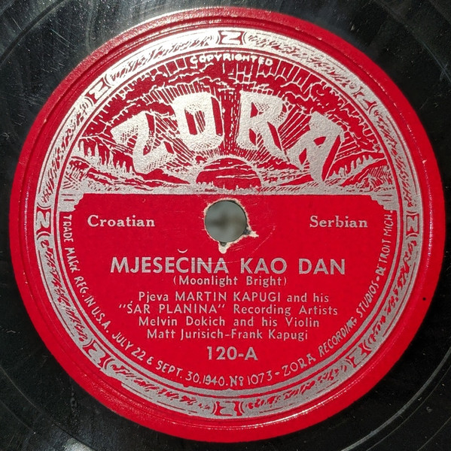
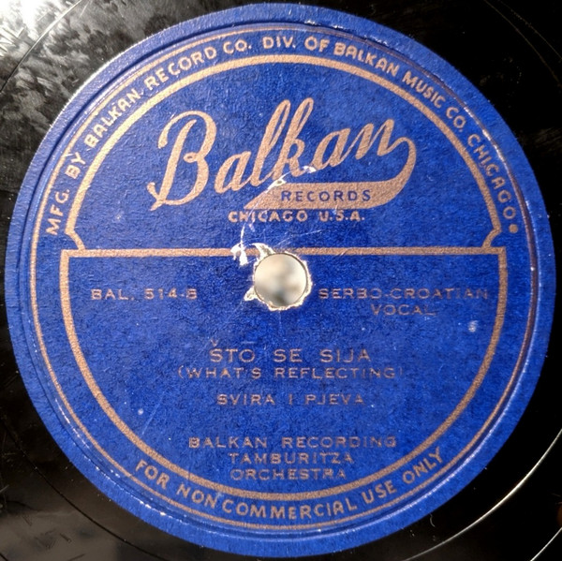
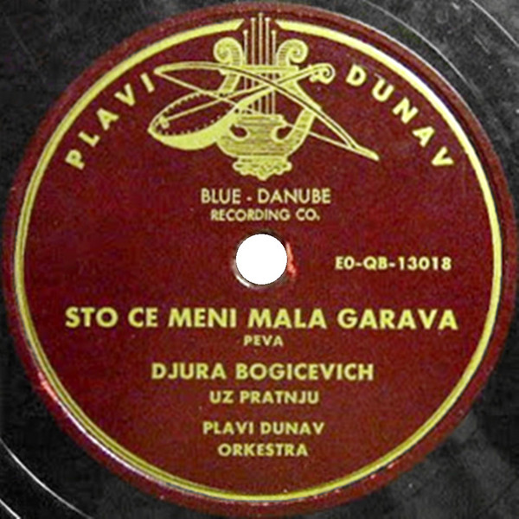

Slide 11

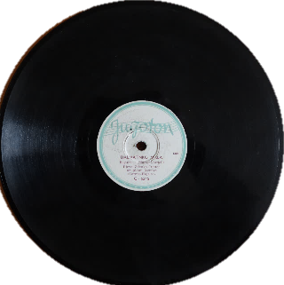

Slide 12
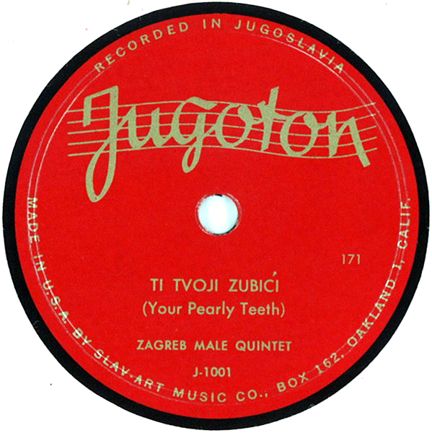
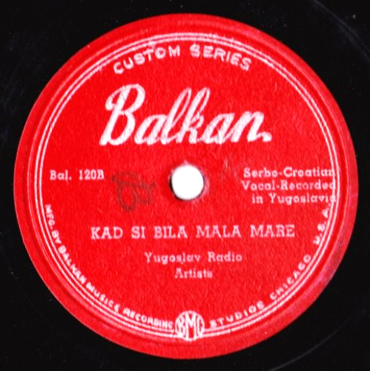
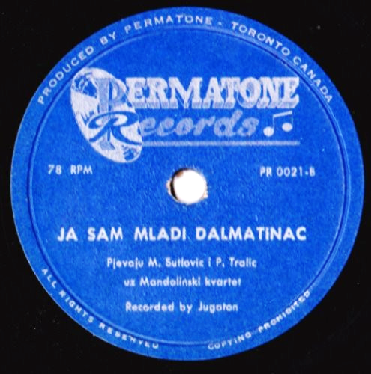

Slide 13
JUGODISK
CUSTOMERS
REPERTOIRE
JUGOTON
HOMELAND
COLLECTOR
VICTOR &
COLUMBIA
3 STORES
IMMIGRANT
ETHNICS
KOLO
CROAT
KOLO
FESTIVAL
OAKLAND
YUGOSLAV
PRICE
COMPETITION
LOS ANGELES
SAN FRANCISCO
SLAV-ART MUSIC CO.
YUGOSLAV REC. SHOP
INTER-
NATIONAL

Slide 14
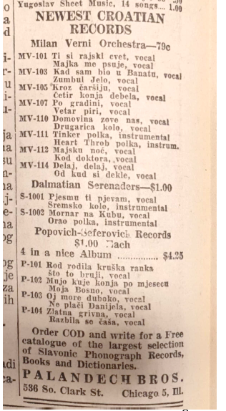
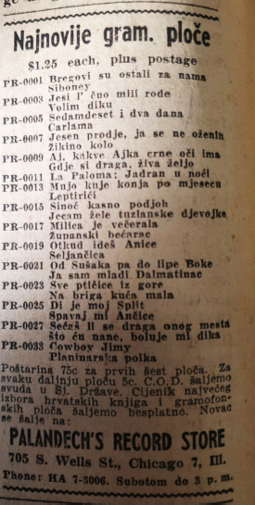
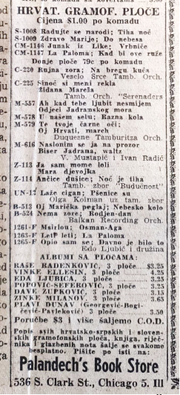
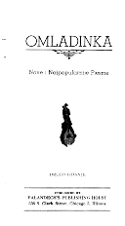

Slide 15
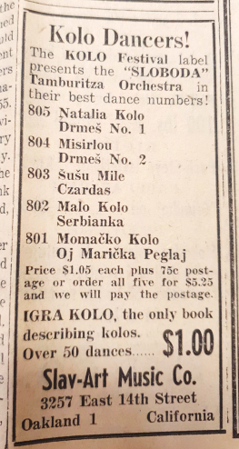
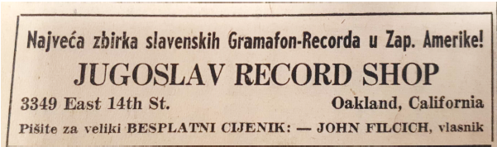

Slide 16
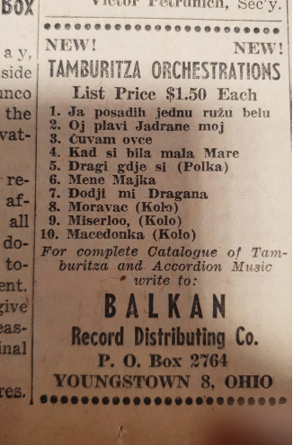
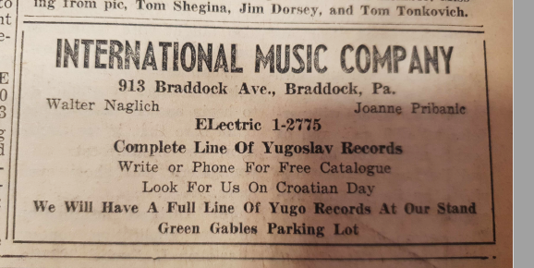
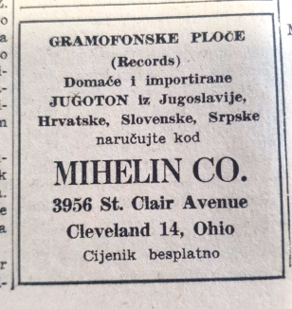
D. Dunatov: Records, music, shops and kolo

Slide 17
JUGODISK
CUSTOMERS
REPERTOIRE
JUGOTON
HOMELAND
COLLECTOR
VICTOR &
COLUMBIA
3 STORES
IMMIGRANT
ETHNICS
KOLO
CROAT
KOLO
FESTIVAL
OAKLAND
YUGOSLAV
PRICE
COMPETITION
LOS ANGELES
SAN FRANCISCO
SLAV-ART MUSIC CO.
YUGOSLAV REC. SHOP
INTER-
NATIONAL
D. Dunatov: Records, music, shops and kolo

Slide 18
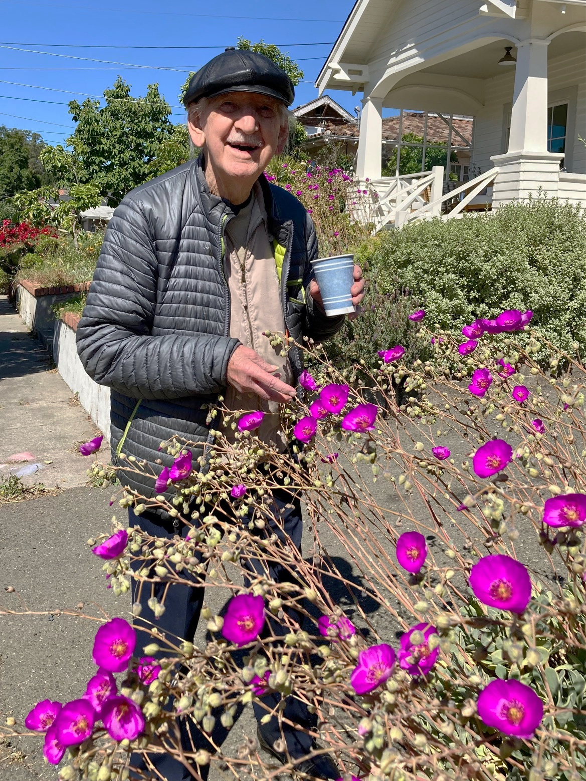

ddunatov@ief.hr
Petaluma, CA. 20/5/2022
Photo credit: Geoffrey Nowak
D. Dunatov: Records, music, shops and kolo

